Slide 1







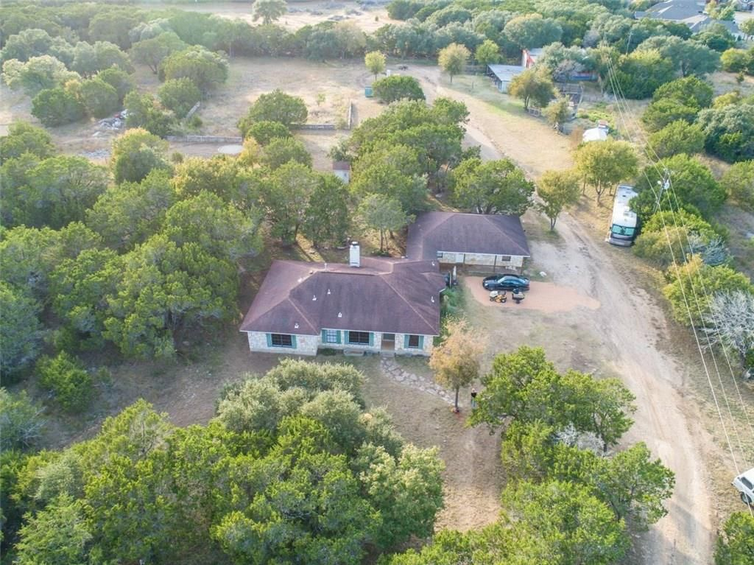




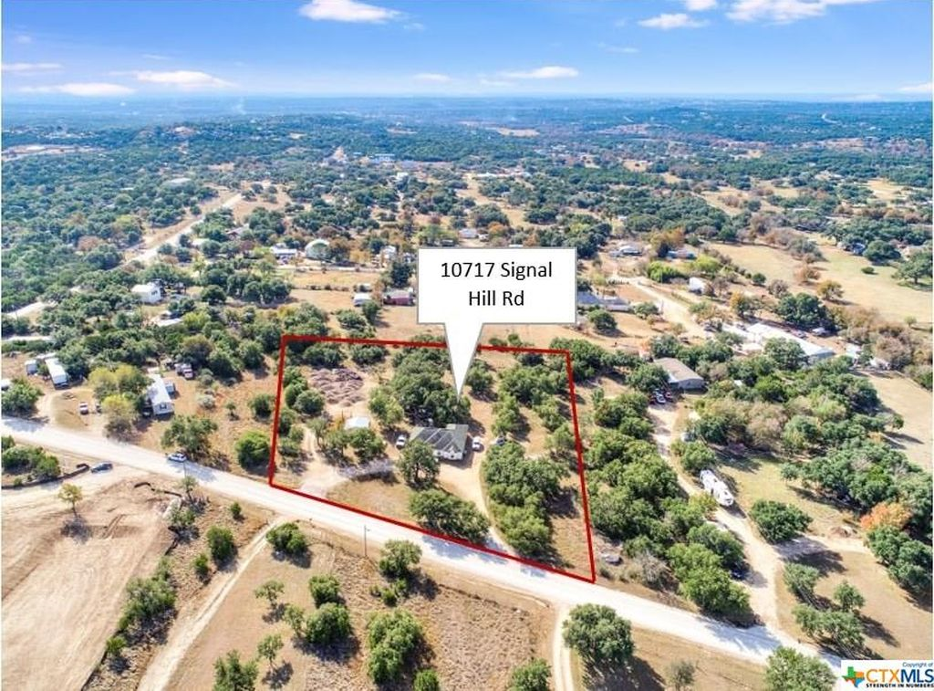
Austin, TX - House Listings
DATA ANALYSIS OF THE HOUSING MARKET
Prepared by: Nina Sysoeva

Slide 2
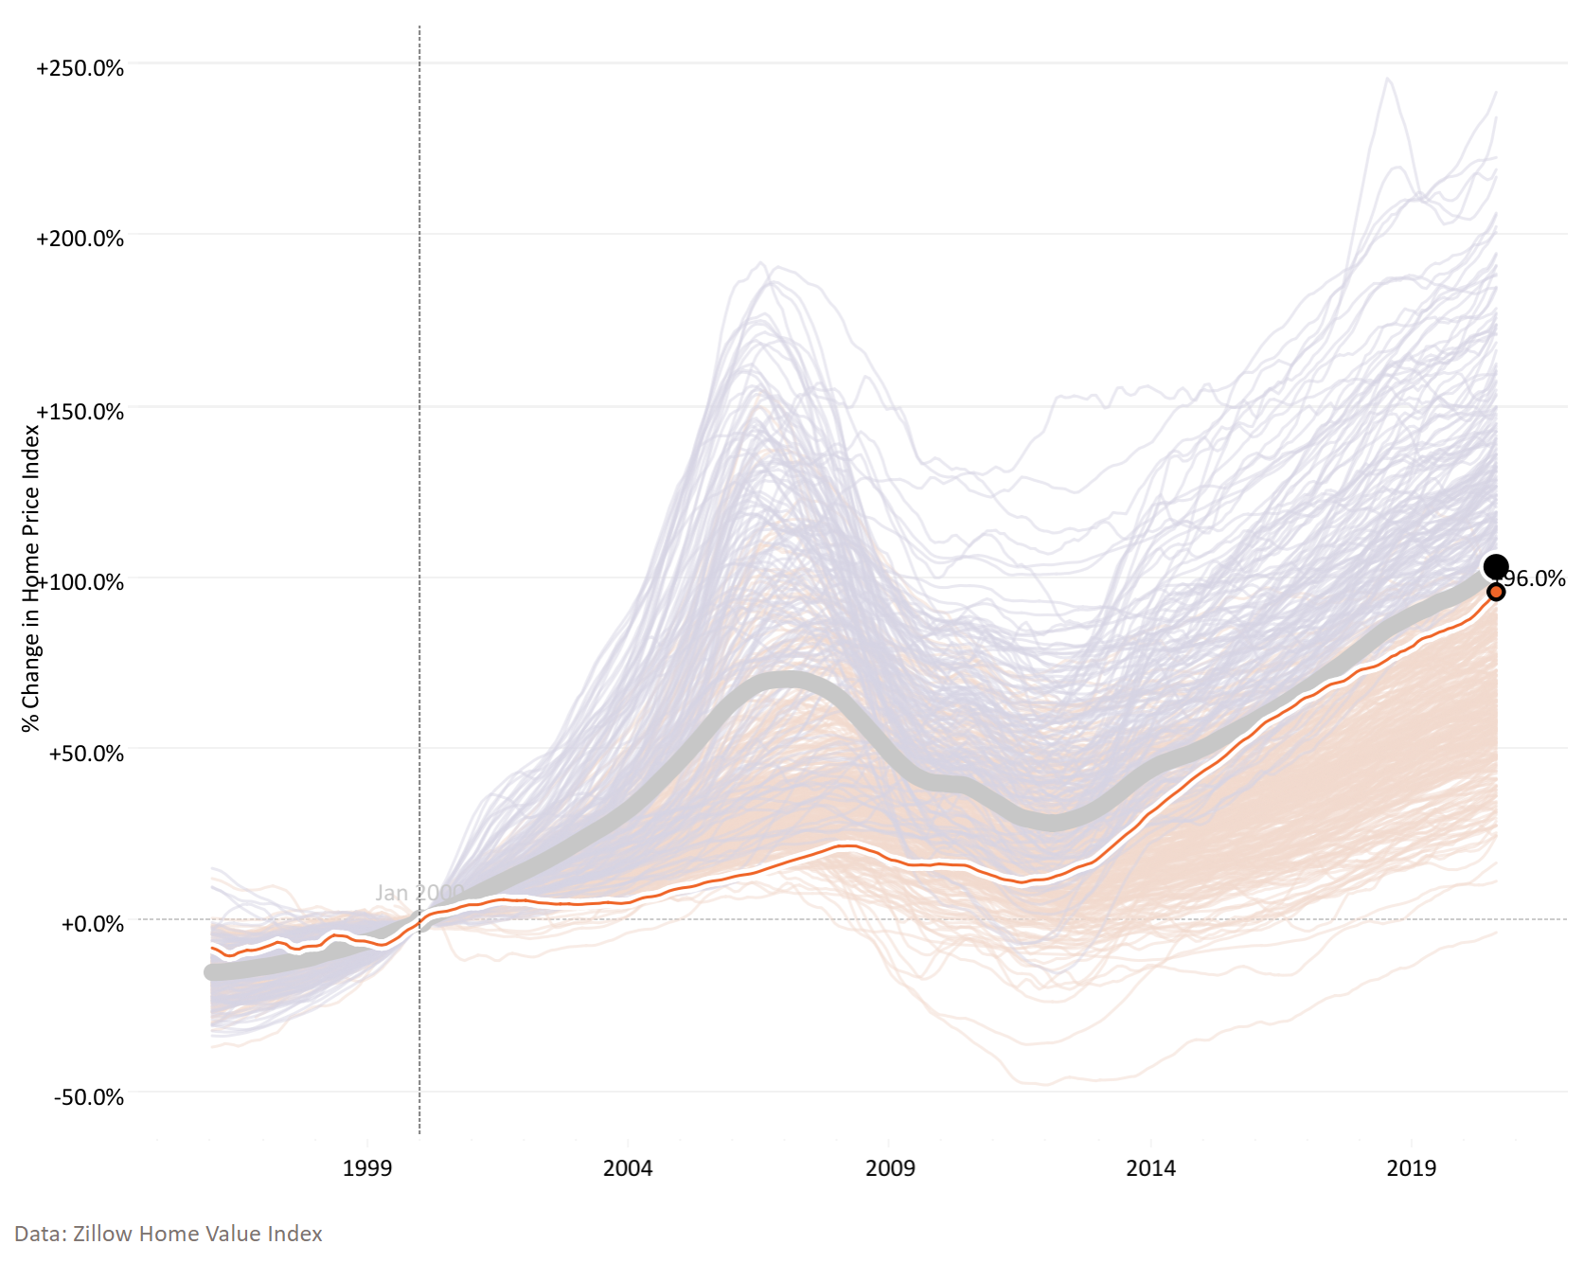
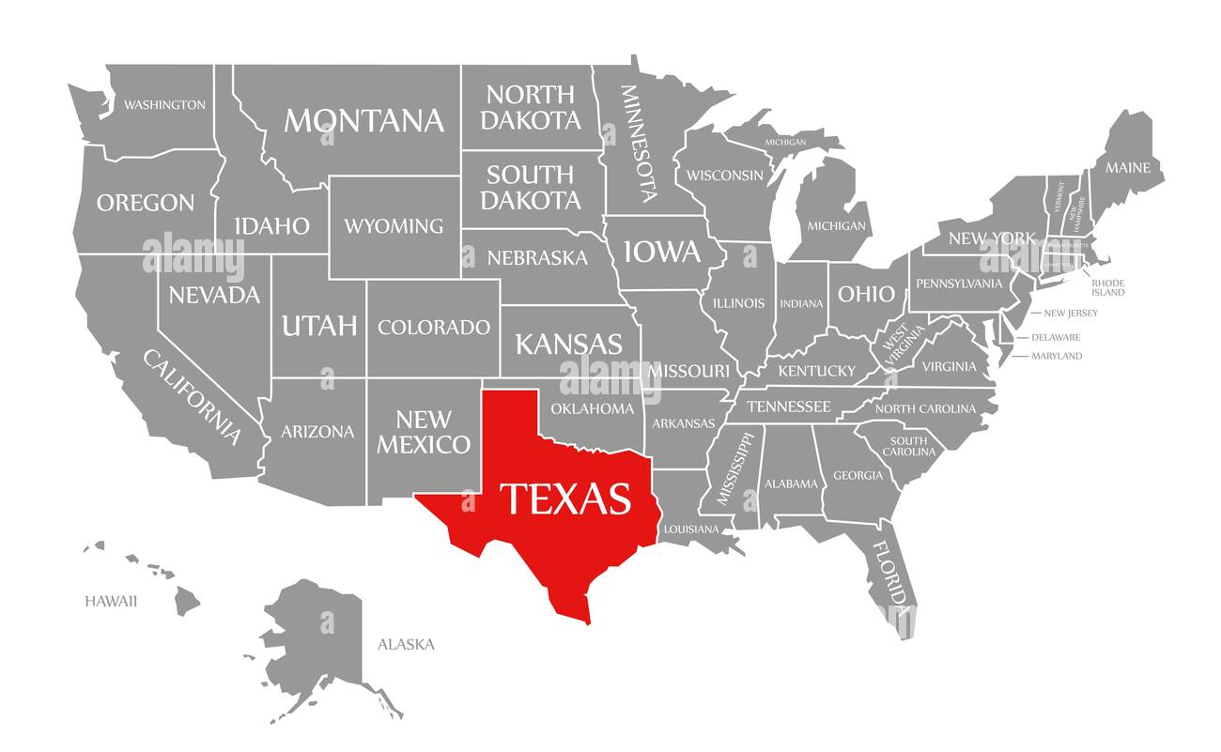
Austin 20-Year Home Price Index Growth Is Comparable to the U.S. Average
Home Price Index Change Across U.S. Metro Areas: Jan 2000 – Aug 2020
 | Austin, TX | U.S. Avg.
Difference Jan 2000 – Aug 2020 | +96% | +103%
Home Price Index (Aug 2020) | $357k | $257k
U.S. Avg.
Austin, TX
Our dataset was scraped in Jan 2021
https://www.visualcapitalist.com/20-years-of-home-price-changes-in-every-u-s-city/
Notes:
To set the stage, here is the U.S. home price index.
Home Price Index = average home value (single-family home)
We are looking at prices from 2000 onwards
First, the trajectory of home prices is defined by the 2008 Financial Crisis. After prices took a steep dive, it took a full decade for the average home price to rise back up to the 2007 peak.

Slide 3
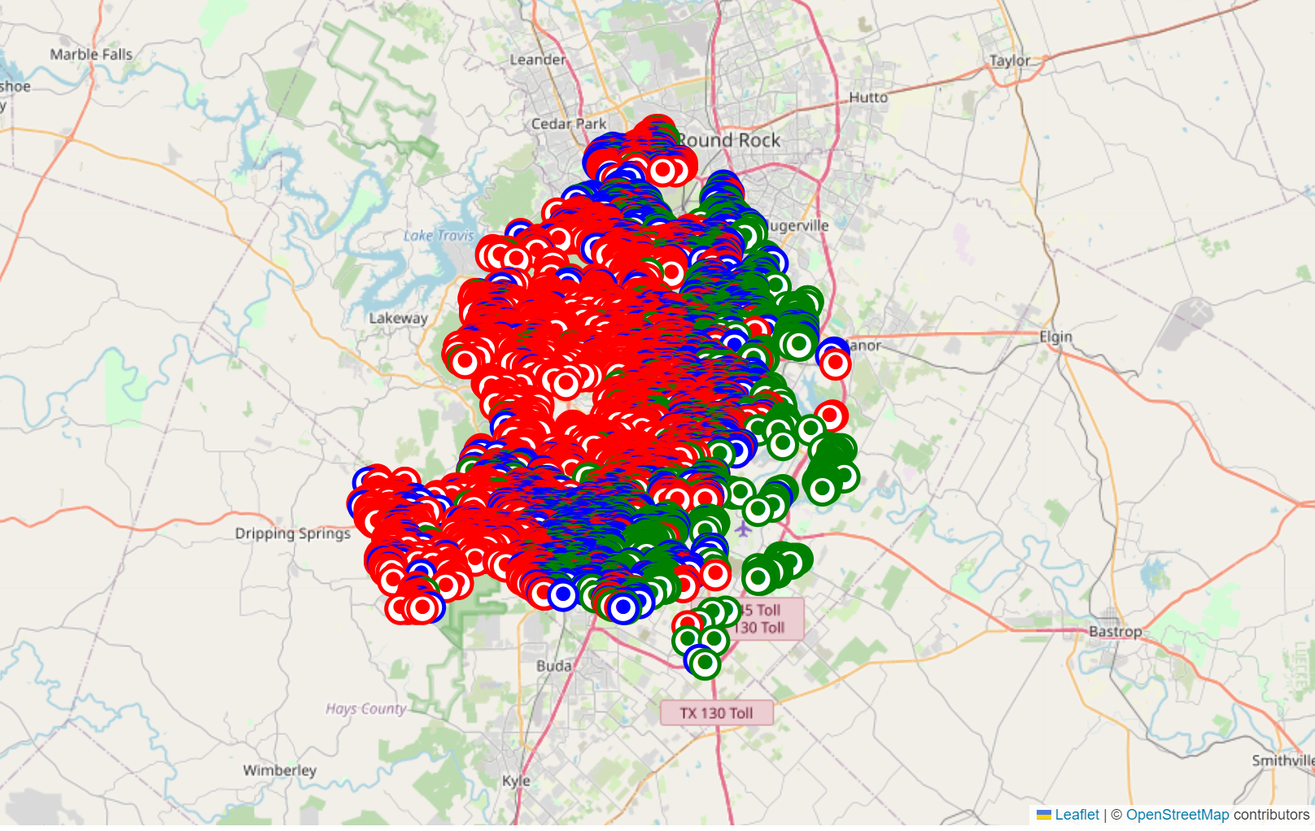
Housing Properties Clustered Around Austin Based on Their Price Bracket
12 MB
<$309k (1st Quartile)
<$405k (Median)
47 Features
>$405k
Austin
~15,000 Rows
Based on Zillow Listings
Targeting to Predict Housing Price column (“latestPrice”) – dependent variable
Notes:
As the next step, we investigated the data further. It contained no duplicates and only a few missing values in the description column. Because the missing values were very few (2), we have removed the rows that contained them. Further, we have looked at the geographic map of housing properties and identified that the properties generally cluster by price, with those <$309k (1st quartile of the distribution) located on the east side of the city, those between $309k and $405k (where $405k is the median value) spread in the middle of the city, from north to south, and those >$405k located in the central and western edge of the city.

Slide 4
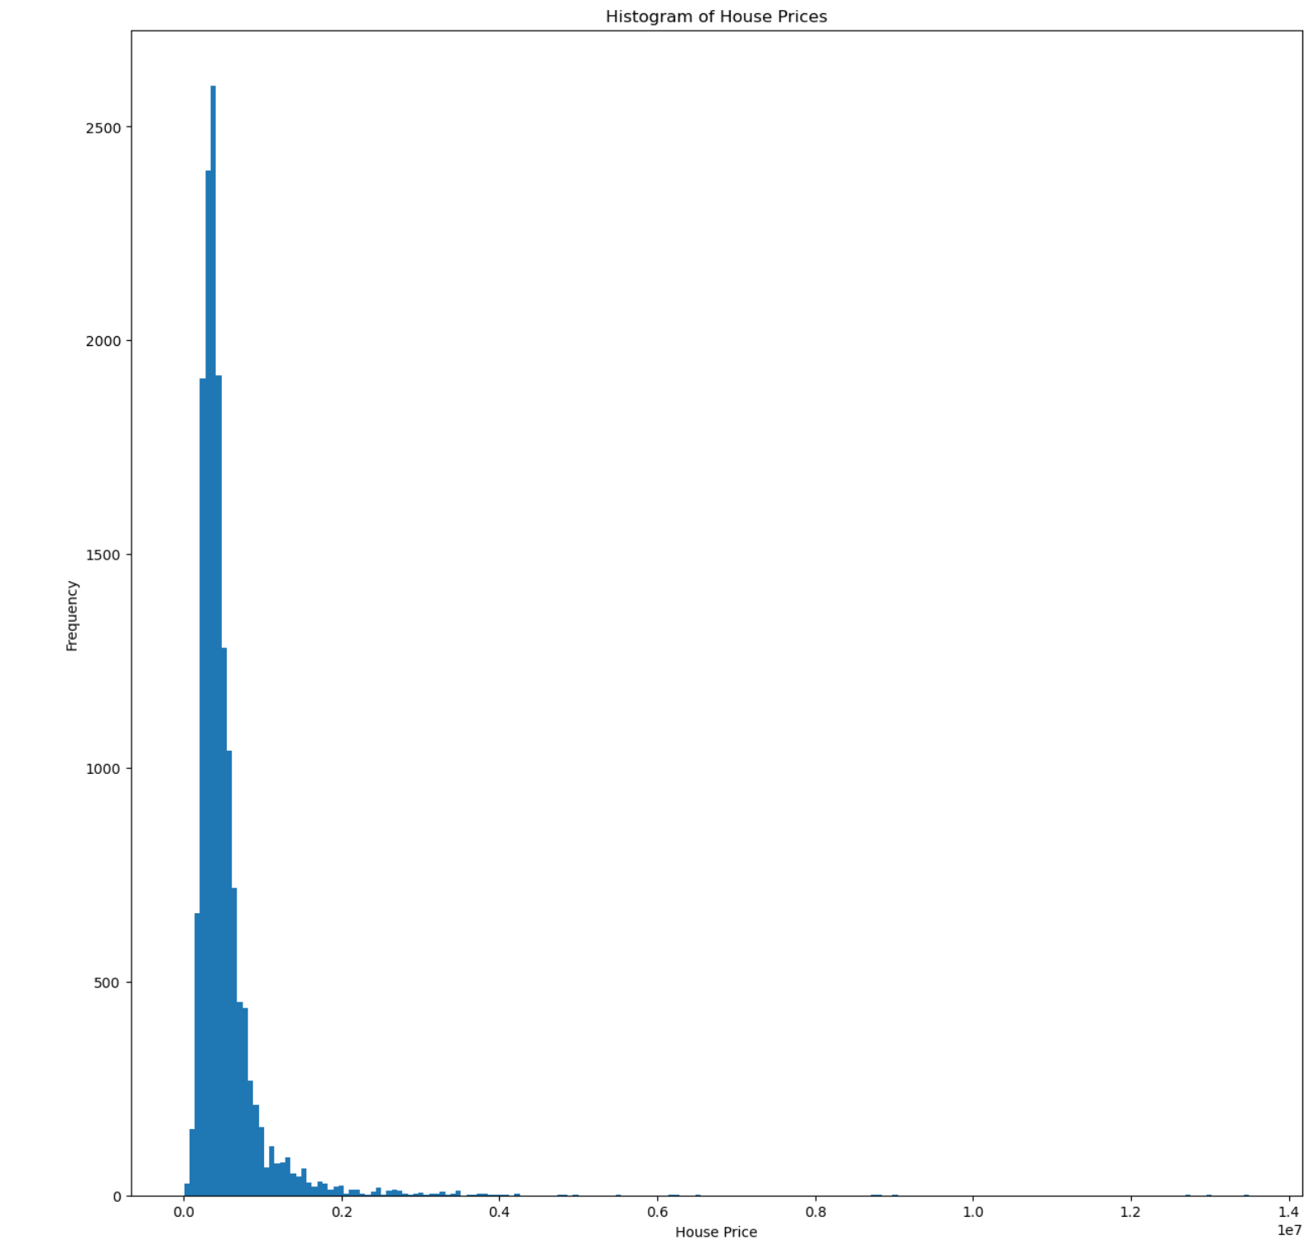
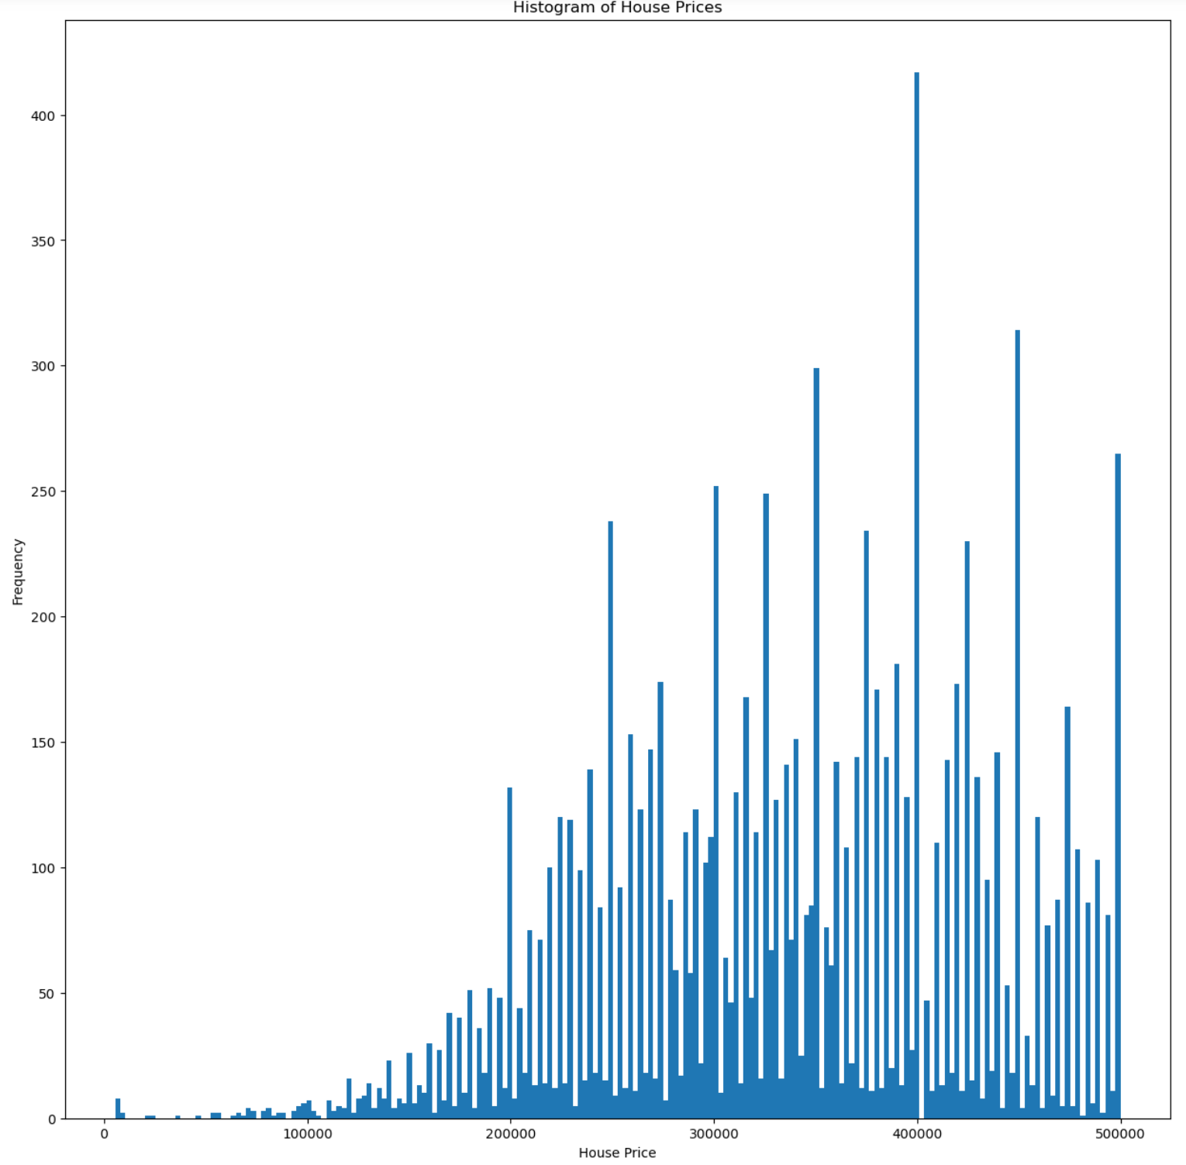
Removing Outliers Moved Linear Regression Train & Test Scores Closer Together and Adjusted Magnitudes of the Coefficients
$13.5M – highest housing price in dataset
Removed outliers: where House Price > $500,000
Notes:
Later in our analysis, we have revealed that our dependent variable (Price) has outliers going up to $13.5M. We have then chose to eliminate the outliers and run some of the regression models on data which excludes rows where housing prices are >$500k.

Slide 5

Two Linear Regression Iterations Resulted in Accuracy of ~30%
INDEPENDENT FEATURES COUNT
PROCESS DESCRIPTION
46
1
“description” column – processed using NLP
“city” and “homeType” columns → dummy variables
154
2
Sequentially dropped features with correlation >0.5
No multicollinearity identified
124
3
Dropped features that had p-values >0.05
Linear Regression
55
4
Initial
Linear Regression
55 features; large coefficients
Removed outliers
Linear Regression
Dropped features that had p-values >0.05
28
5
Train Score: ~31%
Test Score: ~33%
Notes:
For CountVectorizer, we have capped the maximum features at 100 and dropped tokens used <10 times from the vocabulary.
Also, dropped a few columns (such as Zillow identifier) that were not meaningful as first step
Before removing outliers: Train = 33%
Test = 41%

Slide 6
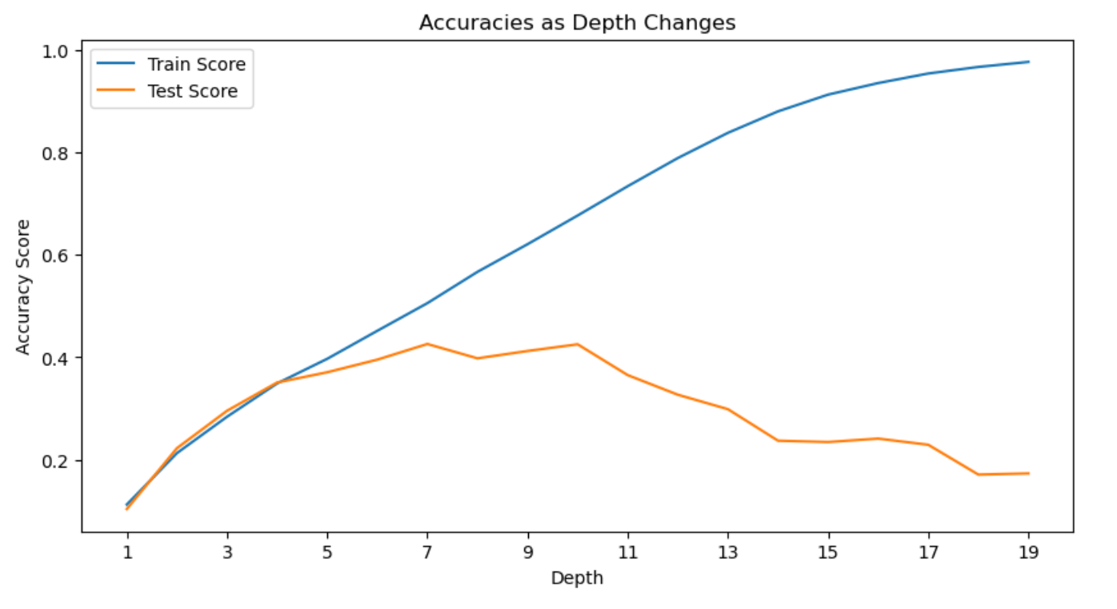
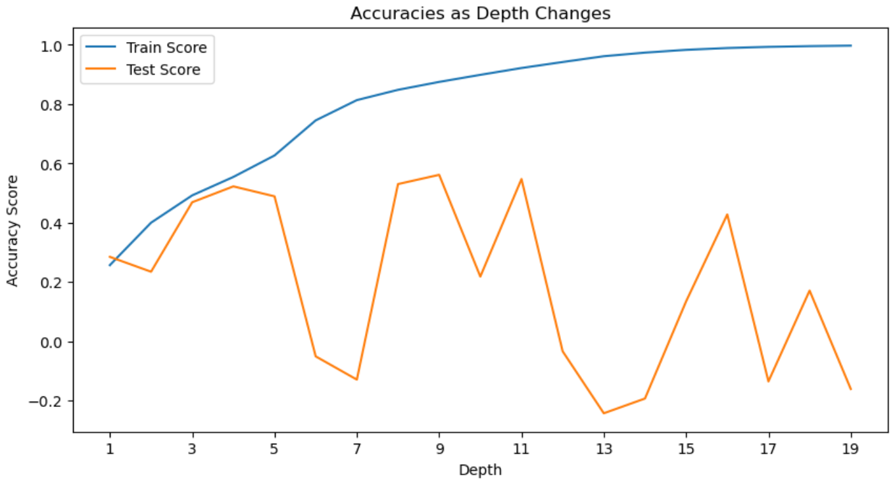
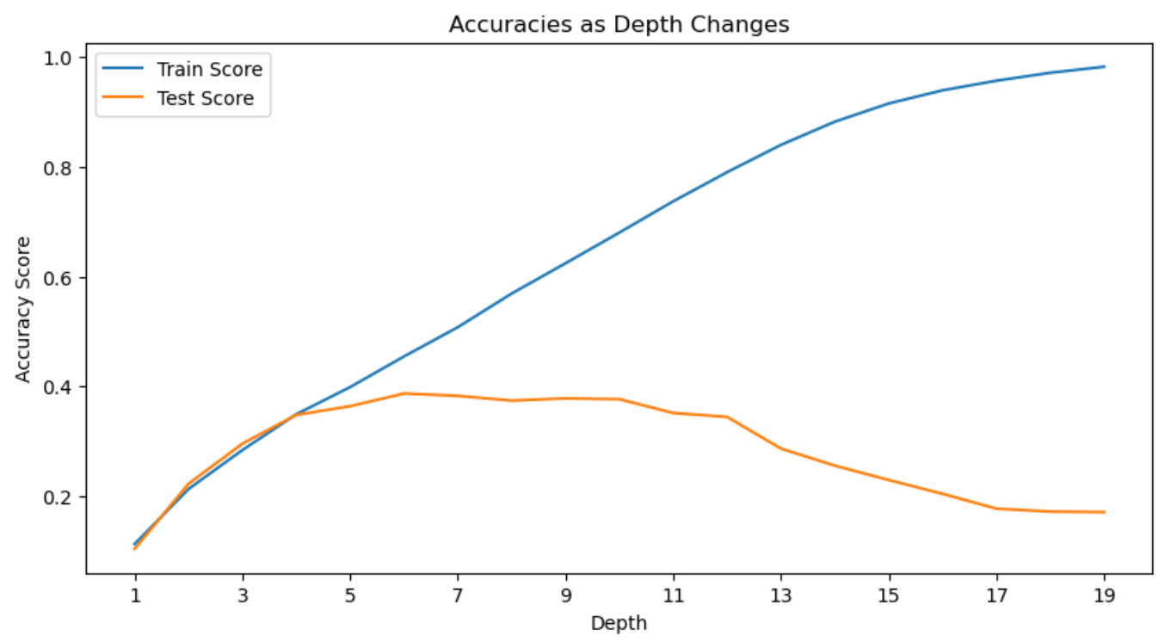
Decision Tree Regressor (with 4 Nodes) Provides 52% Accuracy in 2nd Scenario
28 Independent Features
Train Score: 35%
Test Score: 35%
124 Independent Features
Train Score: 55%
Test Score: 52%
124 Independent Features & Removed Outliers
Train Score: 35%
Test Score: 35%

Slide 7
Conclusions & Next Steps
Decision tree regressor (before removing outliers) gives the best accuracy result of 52%
However, I would generally expect higher accuracy (70-80%) given the good amount and relevancy of the independent features available to us
Next steps – explore other available regressor models attempting to identify one with a higher test score
Optimize hyperparameters of other available regressor models to tune up their performance
Notes:
Overall, I would expect a higher accuracy score from the model, perhaps closer to 70-80%. It appears that we have a plenty of relevant independent variables accessible to us. The only model anywhere remotely close to my projection is decision tree regressor on 124 independent variables (before removing outliers, so on all 15,171 rows of the data).

